Slide 1
Spotlight Features; Bill Payment & Transfers
Feature list:
Bill Payment Service
InterBank Account to Account Transfer
Intra Bank Fund Transfer
Person to Person Transfer
Transfer between Customer Own Accounts

Slide 2
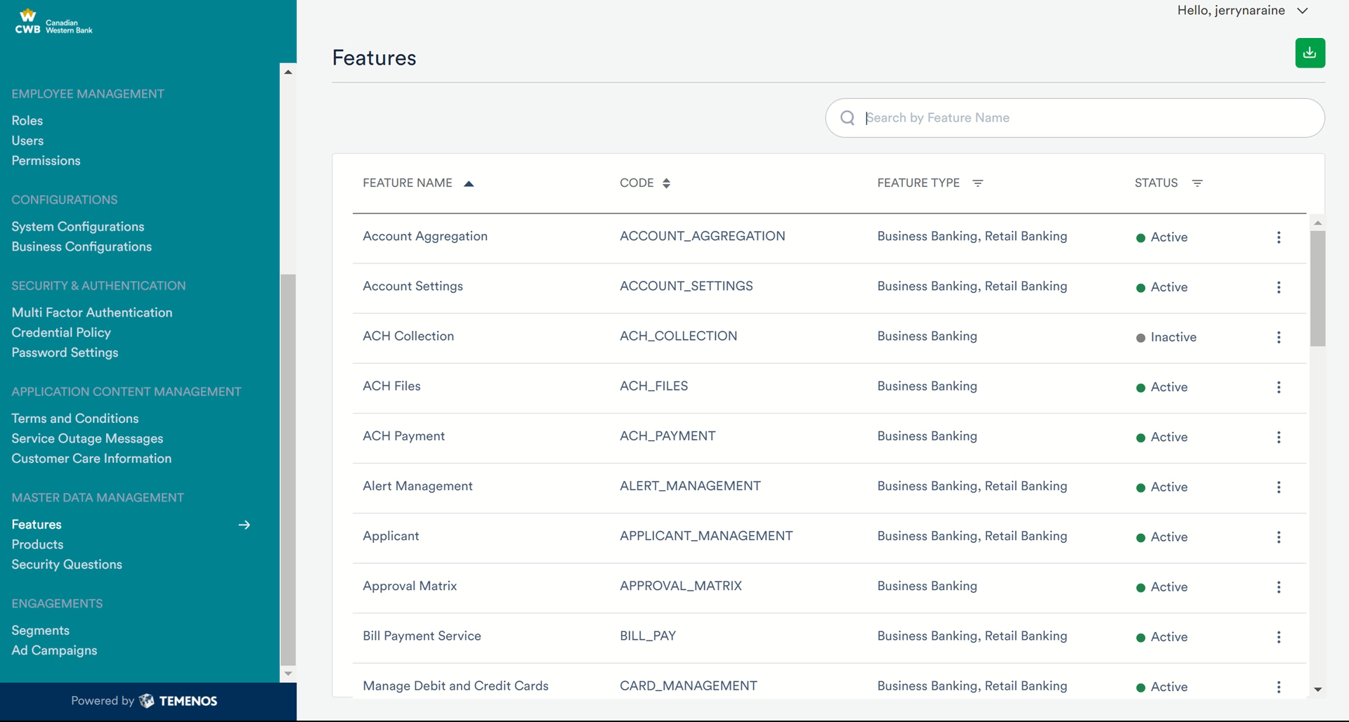
Bill Payment Services Features and Actions

Slide 3
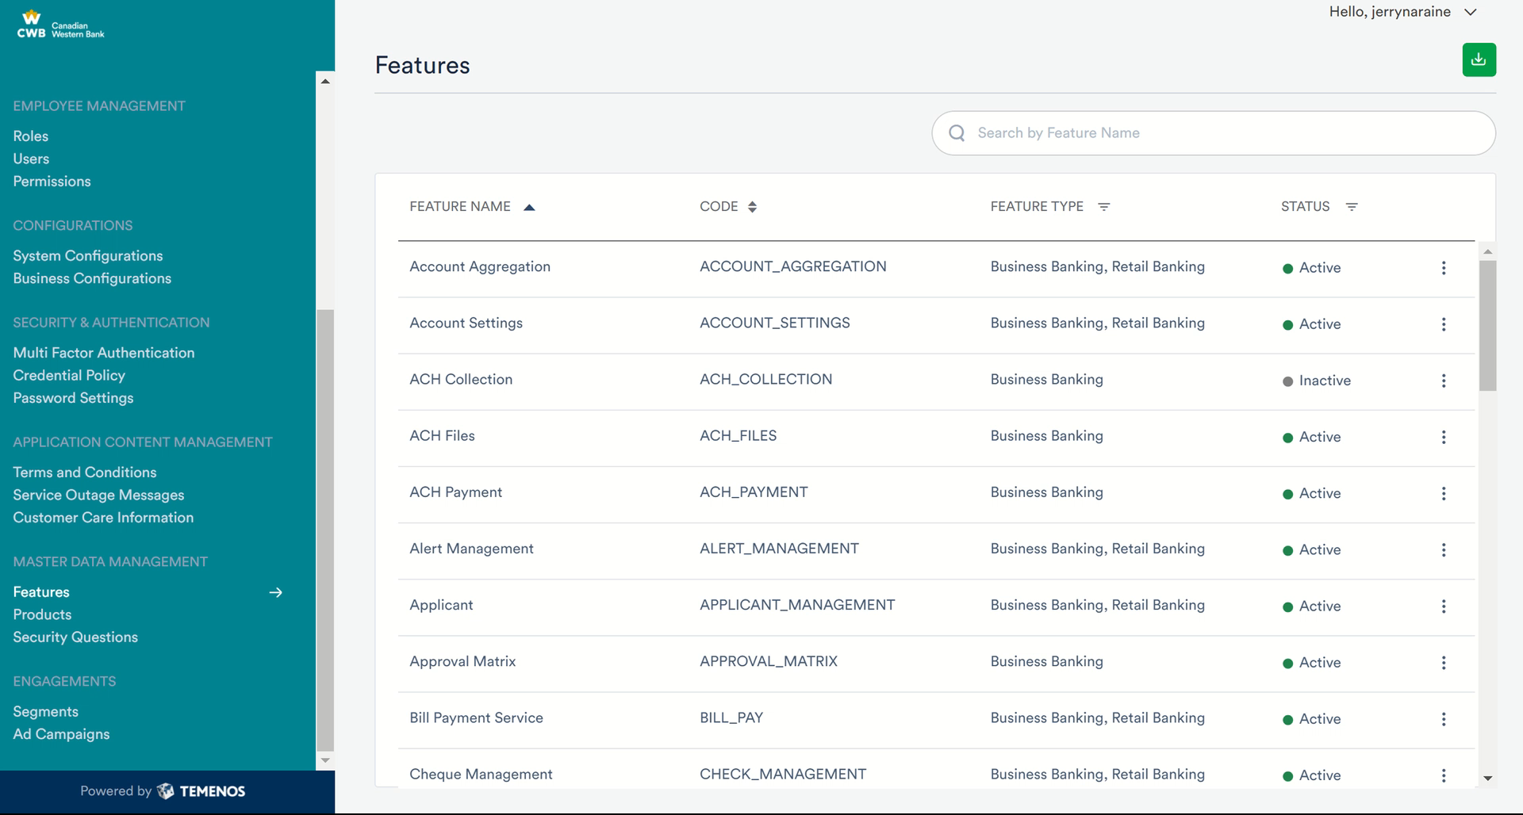
Interbank Account to Account Fund Transfer

Slide 4
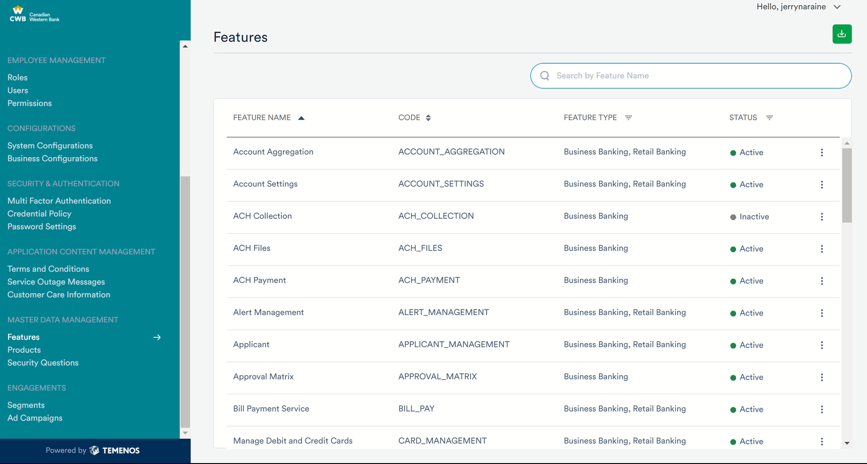
Intra Bank Fund Transfer

Slide 5

Person to Person Transfer

Slide 6
Transfer Between Customer Own Account

